Slide 1
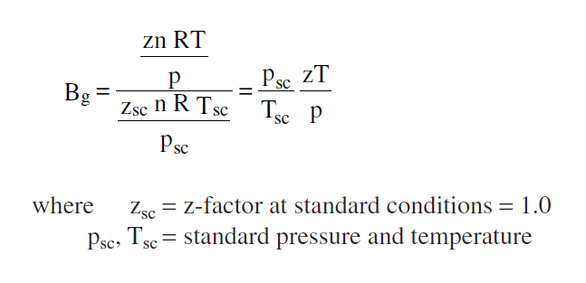
GAS FORMATION VOLUME FACTOR

Slide 2
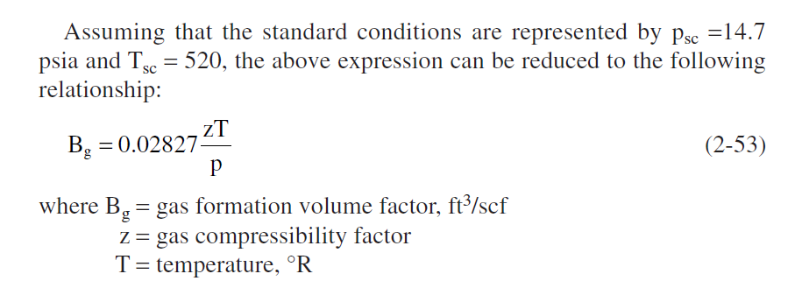

Slide 4
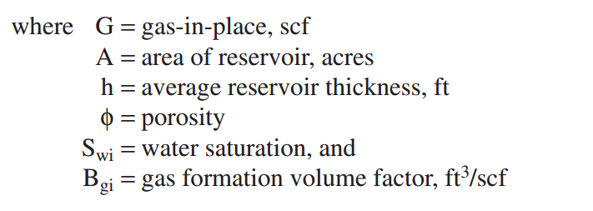
Gas Initial in place G
• Volumetric method • Material balance approach

Slide 7
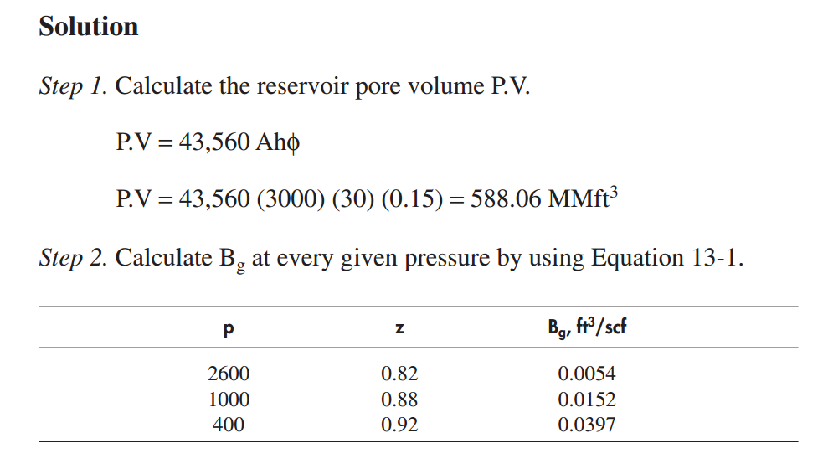

Slide 9
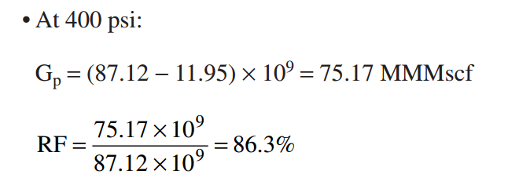

Slide 10
THE MATERIAL BALANCE METHOD

Slide 12
Volumetric Gas Reservoirs

Slide 13
